Slide 1
Real Estate Prices in Mexico City
Keisuke Yokota, Jesus Ramirez, Aleister Montfort
03-09-18

Slide 2
Contents
1. Motivation
2. Data
3. Methodology
4. Results
5. Questions

Slide 3
Motivation
Develop a tool to estimate average real-estate prices in Mexico City at the neighborhood level, and display it together with other relevant information.
The goal is to :
Create a database with accurate information on real-estate prices at the neighborhood level
Integrate real-estate information with other relevant information
Produce visualizations of the spatial distribution of prices with other variables

Slide 4
Data
The sources of our data are multiple:
Real-estate prices:
It comes mainly from 4 different websites
Century 21st, Icasa, Metros Cubicos, Inmuebles 24
~ 80 K raw observations
Data was collected between 2nd-3rd week of February
~ 50 K of clean records were collected
Challenges
Official Sources:
Office of National Statistics (INEGI) for shapefiles, population, services, neighborhoods shapefile
Open Data Sources (CDMX) for earthquake damages
Other public sources (for crime)
Using shapefiles, we analyzed data on temperature, public services, crime and other demographics; estimated population at the neighborhood level, and normalized data when necessary (crime).

Slide 5
Libraries and methods used
Web scraping using ‘beautiful soup’:
Real estate prices for houses and apartments were averaged at the neighborhood level (median was used to display information in maps)
Record Linkage using ﻿’fuzzy wuzzy’ (similar to ‘Jellyfish’)
Folium (Leaflet) and GeoJson for creating map visualizations
Geopandas for computing statistics at the neighborhood level
Seaborn for distribution plots
Other common libraries in Python (Pandas, Numpy, etc)

Slide 6
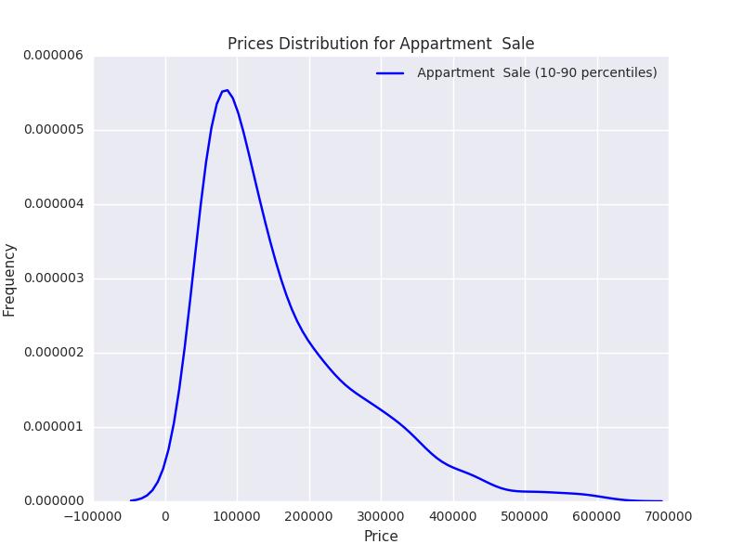
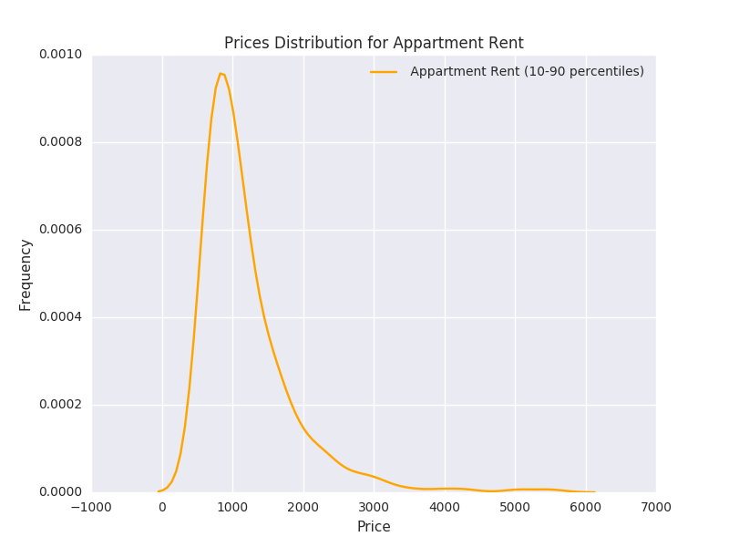
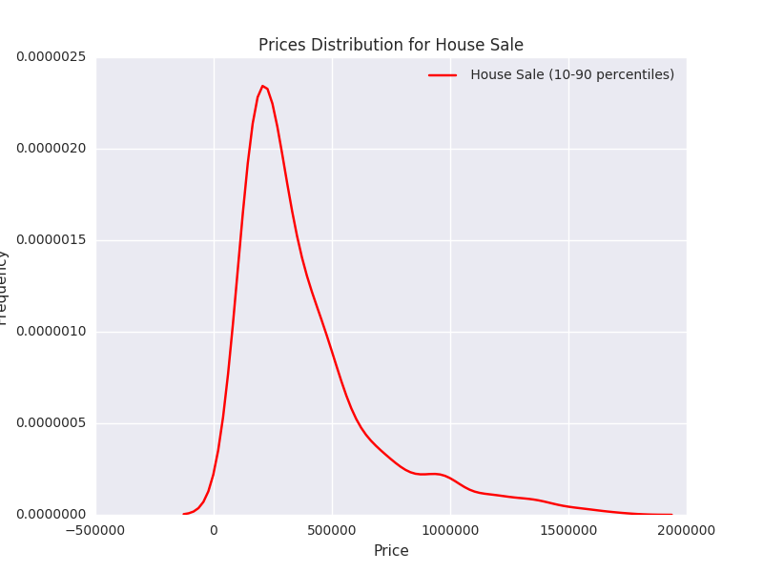
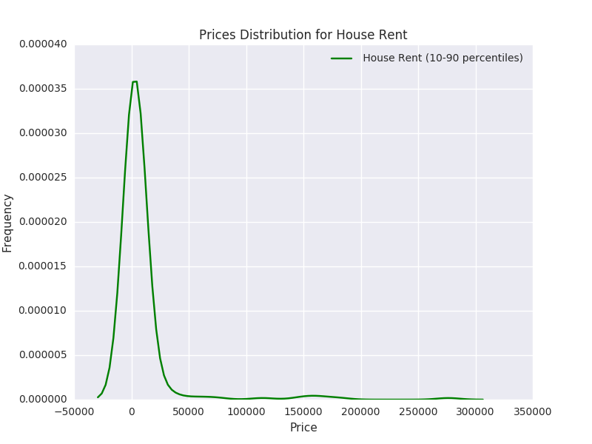
Results (1/2)
 | Count | Median | Mean
Appartment Rent | 12,137 | $1,382 | $57,409
Appartment Sale | 20,784 | $236,660 | $449,358
House Sale | 13,625 | $446,334 | $993,024
House Rent | 2,716 | $3,719 | $20,656
Neighborhoods (polygons) | 2,035 | - | -

Slide 7
Results: examples
1) Earthquake Damages and Houses for sale
file:///User/aleistermontfort/Downloads/'house',%20'sale',%20'%20earthquake'.html
2) Robberies and Apartments for sale
file:///Users/aleistermontfort/Downloads/'appartment',%20'sale',%20'Number%20of%20robberies'.html
3) Number of Schools and Homes for sale
file:///Users/aleistermontfort/Downloads/'house',%20'rent',%20'Number%20of%20Schools'.html

Slide 8
Issues in the future
Improve data quality and increase samples (+ web scraping, time series)
Improve efficiency of web scraping
Uniform way of collecting data from multiple websites
Different information display at the neighborhood level
Friendly user
Use of more buttons
Markers, selection/combination of search criteria (SQL)
Increase rate of survival of observations
More accurate text analysis
Develop a recommendation algorithm with user’s parameters

Slide 9
Questions?

Slide 10
Annex

